Slide 1
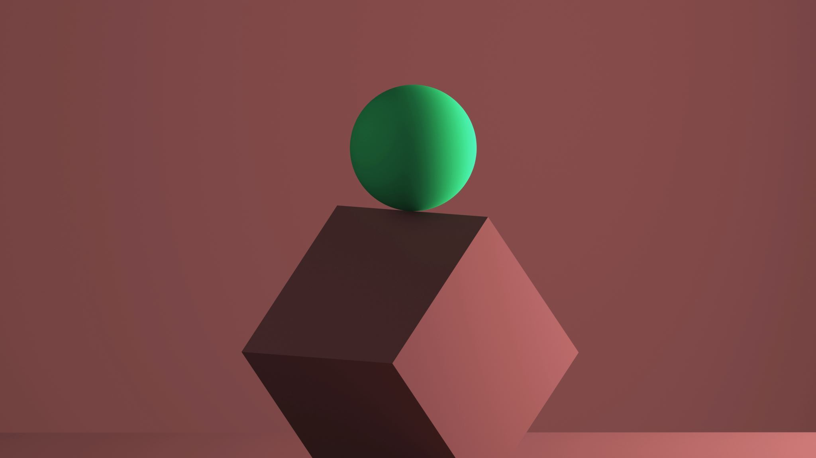
Light Dependent Resistor (LDR)
By Jatasya Raval

Slide 2
What is LDR?
The Resistance of a photoresistor decreases with increasing incident light intensity; in other words, it exhibits Photoconductivity.
When light increases Resistance (Ω) decreases LED will glow brighter.
when Light Decreases resistance (Ω) increases Led will glow dully.
A photoresistor or Light Dependent resistor (LDR) or Photocell is a light-controlled Variable Resistor.

Slide 3
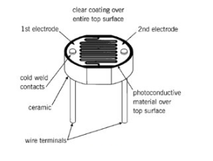
Image of LDR

Slide 4

Circuit symbol of LDR

Slide 5
Thank You

